Slide 1
CSE455 - Software Testing
Chapter 2

Slide 2
Quality Requirements
Products are usually spot-checked to make sure they fulfill the planned requirements in industry
If the final product is flawed or faulty, the production process or the design has to be modified to remedy this

Slide 3
Software is intangible
Product itself isn’t actually tangible, making “hands-on” testing impossible
Visual checks are limited and can only be performed by careful scrutiny of the development documentation

Slide 4
Faulty software is a serious problem
Bad software costs time and money and can ruin a company’s reputation
Can endanger human life—for example, when the “autopilot” software in a partially autonomous vehicle reacts erroneously or too late

Slide 5
Testing helps to assess software quality
Check the quality of a software product to minimize the risk of failures or crashes
It reduces risk by revealing faults at the development stage

Slide 6
Risk of using faulty software
Every release of the VSR-II system has to be suitably tested before it is delivered and rolled out. This aims to identify and remedy faults before they can do any damage. For example, if the system executes an order in a faulty way, this can cause serious financial problems for the customer, the dealer and the manufacturer, as well as damaging the manufacturer’s image. Undiscovered faults like this increase the risk involved in running the software.

Slide 7
Testing involves a spot-check approach
Testing is often understood as spot-check execution of the software in question (the test object) on a computer.
The test object is fed with test data covering various test cases and is then executed

Slide 8
Testing involves more than just executing tests
Involves a range of separate activities:
Performing test
Checking results
Test planning
Test analysis
Design & Implementation of test cases
Writing reports on test progress
Risk analysis

Slide 9
No large system is fault-free
Software systems go live, even though faults still occur for certain combinations of input data
You cannot be sure that additional tests won’t reveal previously undiscovered faults

Slide 10
Defect
Failure to fulfill a predefined requirement, or a discrepancy between the actual behavior (at run time or while testing) and the expected behavior (as defined in the specifications, the requirements, or the user stories)
When does the system’s behavior fail to conform to its actual requirements?

Slide 11
Fault causes failure
Failure is caused by a fault in the software, and the resulting condition is considered to be a defect.
The word “bug” is also used to describe defects that result from coding errors, such as an incorrectly programmed or forgotten instruction in the code
A fault is always the result of an error or a mistake made by a person—for example, due to a programming error at the development stage

Slide 12
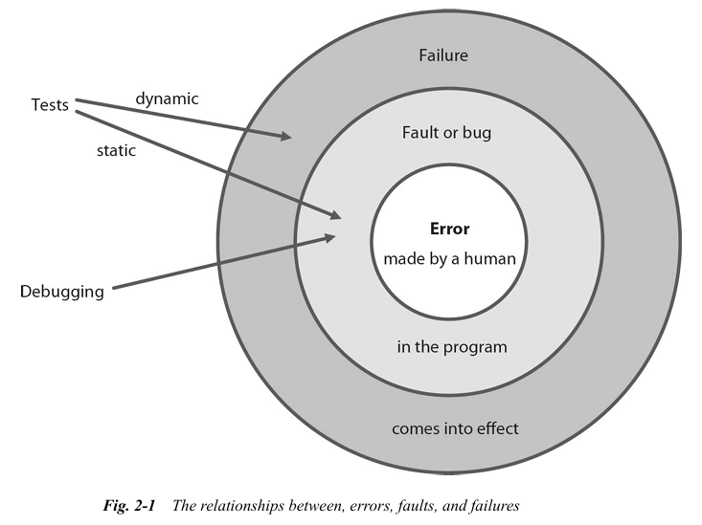

Slide 13
People makes errors
Some typical causes of error are:
Time pressure
Complexity
Misunderstanding b/w participants, different interpretation
Technologies previously unknown to project participants
Lack of participants training, inexperience team members

Slide 14
False positive vs false negative
A test will indicate a failure even though the underlying fault (or its cause) isn’t part of the test object. Such a result is known as a “false positive”
A failure doesn’t occur even though testing should reveal its presence. This type of result is known as a “false negative”

Slide 15
Aspect | Verification | Validation
What it checks? | Are we building product correctly | Are we building the right product?
Focus | Process-oriented (checks documentation, design, and code before execution) | Product-oriented (checks actual product after execution)
When | Before implementation (Static Testing) | After implementation (Dynamic Testing)
How | Reviews, inspections, walkthroughs | Functional testing, system testing, UAT (User Acceptance Testing)
Example | Checking a software design document to ensure all requirements are covered before coding | Testing the developed software to see if it meets customer needs and works as expected

Slide 16
Case study: vague requirements as a cause of software fault
Interest rate the system uses is stored in a table, although the purchase of vehicles involved in promotions and special offers can be subject to differing interest rates. VSR-II is to include the following additional requirement:
REQ: If the customer agrees to and passes an online credit check, the EasyFinance module applies an interest rate from a special bonus interest rate table.
The author of this requirement unfortunately forgot to clarify that a reduction in the interest rate is not permissible for vehicles sold as part of a special offer. This resulted in this special case not being tested in the first release. In turn, this meant that customers were offered low interest rates online but were charged higher rates when billed, resulting in complaints.

Slide 17
Testing is not debugging
Debugging is usually performed by developer while testing by a professional tester, while these roles can switch in a certain development methodology
Debugging is about find the exact line # of code (location) of error
Finding and correcting faults is debugging
Debugging pinpoints software faults, testing is used to reveal effect of fault causes

Slide 18
Confirmation testing
Tests used to check that a fault has been successfully remedied
Fault correction often leads to the creation of new faults that are only revealed when completely new input scenarios are used
Need to write new tests that check for unwanted side effects of the correction process

Slide 19
Objectives of testing
Qualitative evaluation of work product
Prove that all specific requirements have been completely implemented and that the test object functions as expected for the users and other stakeholders
Level of quality-related risk can be reduced through identification and correction of software failures
Analysis of the program and its documentation in order to avoid unwanted faults, and to document and remedy known ones
Analyze and execute the program in order to reproduce known failures
Demonstrate that the test object adheres and/or conforms to the necessary contractual, legal and regulatory requirements and standards

Slide 20
terminologies
Test Artifact: Any document produced during testing process such as test plans, test summary report.
Test Basis: Source of information (requirement) from which test cases are derived, defines the expected behavior of test object
Test Object: Set of test cases covering a single module
Test Item: A single test case in a test object
Test Condition: can be checked using one or more tests, can be a function, transaction or a structural element of a component

Slide 21
Cont.
Test Run: Actual execution of a test case, test object is fed with test data and executed on computer
Test Suite: combined test cases that are executed in a test cycle
Test Execution Schedule: Timing of test cycles when test cases will be executed and after which test case
Test Logs: Test runs are logged and recorded in a test summary report
Test Plan: For every test object, a test plan is prepared which defines everything required to conduct the test

Slide 22
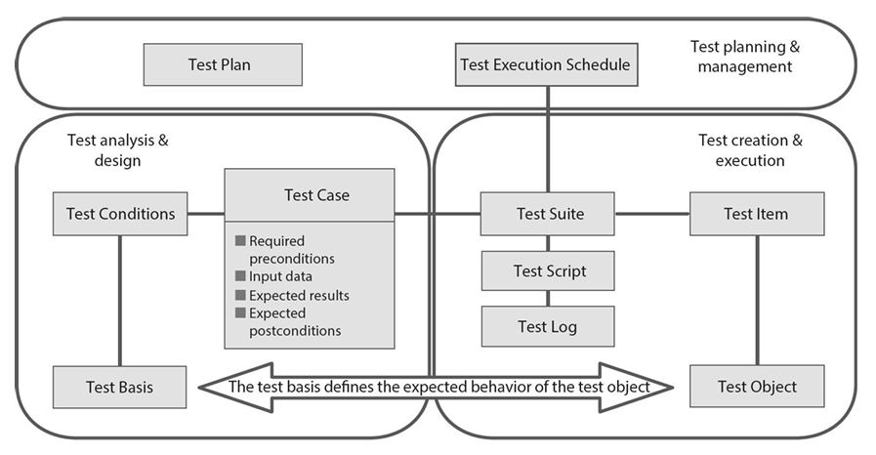

Slide 23
Testing effort
It is difficult to say just how much effort you should spend testing, as this depends very much on the nature of the project at hand
Can be specified as ratio of testers to developers (from one tester for every ten developers to three testers per developer)
Reasonable testing effort always depends on the degree of risk involved in failure and an evaluation of the danger this incurs
System parts with a high risk have to be tested more extensively
Risk assessment has to be carried out for the individual system parts or even for individual failure modes

Slide 24
Cont.
If there is a high risk of a system or subsystem malfunctioning, the test requires more effort than for less critical (sub) systems
A computer game that saves scores incorrectly can be costly for its manufacturer, as such faults affect the public acceptance of a game and its parent company’s other products, and can lead to lost sales and damage to the company’s reputation

Slide 25
Case study: risks and losses when failure occurs
The DreamCar module constantly updates and displays the price of the current configuration. Registered customers with validated ID can order a vehicle online.
Once a customer clicks the Order button and enters their PIN, the vehicle is ordered and the purchase committed. Once the statutory revocation deadline has passed, the chosen configuration is automatically passed on to the production management system that initiates the build process.
Because the online purchase process is binding, if the system calculates and displays an incorrect price the customer has the right to insist on the paying that price. This means that wrongly calculated prices could lead to the manufacturer selling thousands of cars at prices that are too low. Depending on the degree of miscalculation, this could lead to millions of dollars in losses. Having each purchase order checked manually is not an option, as the whole point of the VSR-II system is that vehicles can be ordered completely automatically online.

Slide 26
The cost of failure
In March 2016, a concatenation of software faults destroyed the space telescope Hitomi, which was built at a cost of several hundred million dollars. The satellite’s software wrongly assumed that it was rotating too slowly and tried to compensate using countermeasures. The signals from the redundant control systems were then wrongly interpreted and the speed of rotation increased continuously until the centrifugal force became too much and Hitomi disintegrated.
In 2018 and 2019 two Boeing 737 MAX 8 airplanes crashed due to design flaws in the airplane’s MCAS flight control software. Here too, the software—misdirected by incorrect sensor information—generated fatal countermeasures.

Slide 27
Applying testing skills early ensures success
At requirement stage, Identification and correction of flawed requirements reduces the risk of producing inappropriate or non-testable functionality
At design stage, increased awareness can reduce the risk of producing fundamental construction faults and makes it easier to design appropriate tests
At coding stage, better understanding of the code itself and the tests it requires reduces the risk of producing faulty code and of designing inappropriate tests
At testing stage, if testers verify and validate software before release, they are sure to identify and remedy additional faults that would otherwise remain undiscovered

Slide 28
Basic principle of testing
1. Testing shows the presence of defects, not their absence
If an object doesn’t fail during testing, this is no proof of freedom from faults or overall correctness.
2. Exhaustive testing is impossible
It is impossible to design and perform a complete test suite that covers all possible combinations of input data and their preconditions.
3. Early testing saves time and money
Helps to avoid (or at least reduce) the increasingly costly repair of faults later in the development lifecycle.
4. Defects cluster together
Most defects can usually be found in a small number of modules. Testing effort can then be concentrated on the most relevant parts of the system.

Slide 29
Cont.
5. Beware the pesticide paradox
Over time, tests become less effective the same way insects develop resistance to pesticides. Check your test cases regularly and, if necessary, modify them or add new ones.
6. Testing is context-dependent
No two systems can be effectively tested the same way. An embedded system requires different tests than, for example, an e-commerce system. Testing in an agile project will be very different from that in a project based on a sequential life cycle model.
7. Absence-of-errors is a fallacy
Even if you test all requirements comprehensively and correct all the faults you find, it is still possible to develop a system that is difficult to use. Prototyping and early involvement of a system’s users are preventive measures used to avoid this problem.

Slide 30
Quality management and quality assurance
Quality management (QM) covers all organizational activities and measures that serve to control quality
Quality assurance (QA) usually concentrates on measures which aim to ensure that specified procedures are applied and defined processes are adhered to
QA generates confidence in the fulfillment of quality requirements, which can be achieved by testing
QA is about making sure such processes are implemented and executed correctly

Slide 31
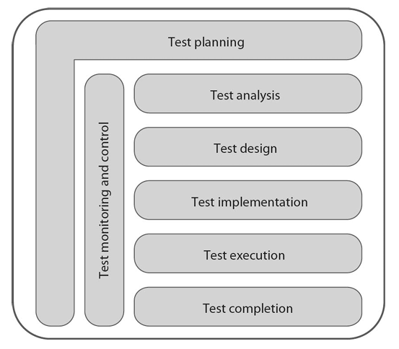
Testing process
This model is quite unrealistic due to sequential activities

Slide 32
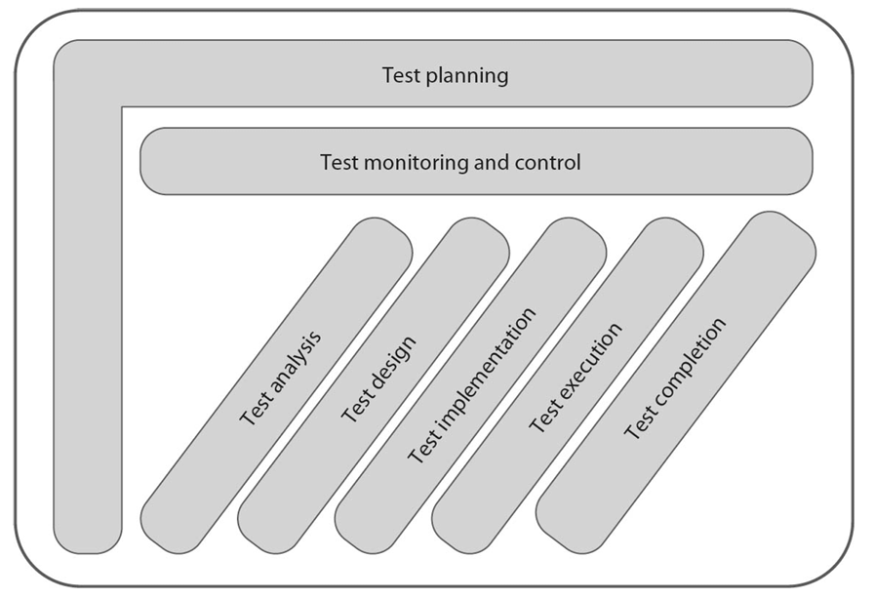
Cont.
This model accurately represents testing process due to time overlap between activities

Slide 33
Cont.
A testing process is generally comprise of following activities:
Test planning
Test monitoring and control
Test analysis
Test design
Test implementation
Test execution
Test completion

Slide 34
Iterative testing
Software is often developed in small iterative steps—for example, agile development methods use continuous build and test iterations. The corresponding test activities therefore need to take place continuously and iteratively

Slide 35
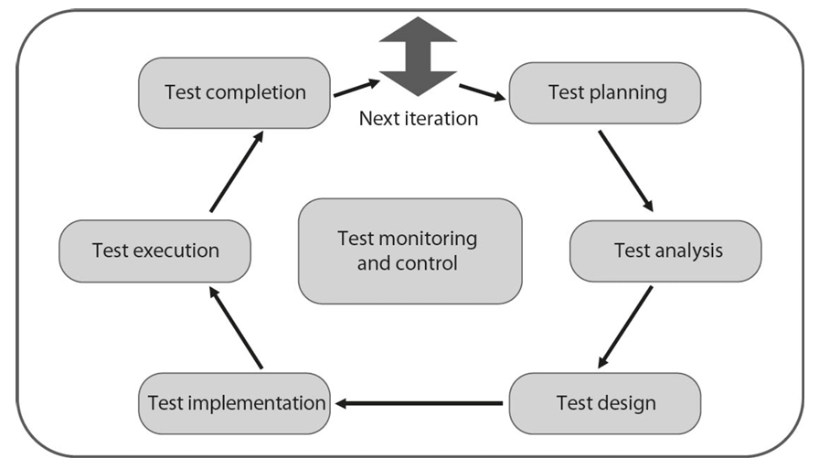

Slide 36
Test planning
Testing will not work without a plan
Begins directly at the start of a software project
Update or adapt it to fit changing situations and project parameters
Adjusted throughout the entire product lifecycle
Created based on testing strategy chosen
Includes required resources, time to perform the corresponding activities
Also defines which tests are to be performed at which test level, makes sense to draft a separate test plan for each test level

Slide 37
Cont.
Coverage criteria: Verify when you have reached the testing objectives
Traceability: between test basis and result of test activities
Scheduling: Test schedule contains a list of all activities, tasks and/or events involved in the test process. It also includes planned start and end date for every activity and interdependencies between activities

Slide 38
Test monitoring and control
Constant observation of the current testing activities compared with the planned activities
If the predefined criteria are fulfilled, the activity can be terminated
If risk evaluation is part of the test plan and you need to prove that you have sufficient risk coverage
If the required exit criteria have not been fulfilled by the tests you have performed, you need to design and execute additional tests
Any deviation from the original plan, these reports should also contain information regarding any prematurely terminated tests

Slide 39
Test analysis
Involves determining what exactly needs to be tested
If a requirement doesn’t specify the predicted result and/or system behavior precisely enough, then test cases cannot be simply derived
Cornerstone of the entire testing process is the test basis. If the test basis contains defects, you cannot formulate “correct” test conditions and you won’t be able to draft “proper” test cases, whether it contains ambiguities, or whether there are gaps or omissions in the descriptions of functions
Once the test conditions have been identified and defined, you need to prioritize them, time restrictions often make it impossible to perform all the planned tests
Unambiguous bi directional traceability between the test basis and the results of your testing activities defines which test condition checks which requirement
Consider which test technique to use (i.e., black-box, white box, experience-based)

Slide 40
Test design
Test conditions are used to create test cases (or sequences of test cases)
Test cases can be specified on two “levels”: abstract and concrete
An abstract (or “high-level”) test case doesn’t include specific input values or expected results, and is described using logical operators
Concrete (or “low-level”) test case uses specific input data and expected result values
Only concrete test cases can be executed on a computer
Abstract test cases can be derived from concrete cases too
Test oracle for predicting test results, specification can serve as oracle

Slide 41
example
A dealership can give its salespeople the option of discounts to apply to the price of a vehicle. For prices below $15,000 there is no discount. For prices up to $20,000, a discount of 5% is appropriate. If the price is below $25,000, a 7% discount is possible. If the price is above $25,000, a discount of 8.5% is to be applied. The above text enables us to derive the following relationships between price and discount:
Price < 15,000 Discount = 0%
15.000 ≤ Price ≤ 20,000 Discount = 5%
20.000 < Price < 25,000 Discount = 7%
Price ≥ 25,000 Discount = 8.5%

Slide 42
Cont.
Abstract Test Cases | 1 | 2 | 3 | 4
Input value x (price in $) | x < 15000 | 15000 ≤ x ≤ 20000 | 20000 < x < 25000 | 25000 ≤ x
Predicted result (discount in %) | 0 | 5 | 7 | 8.5

Slide 43
Cont.
Concrete Test Cases | 1 | 2 | 3 | 4
Input value x (price in $) | 14500 | 16500 | 24750 | 31800
Predicted result (discount in %) | 14500 x 0/100 = 0 | 16500 x 5/100 = 825 | 24750 x 7/100 = 1732.5 | 31800 x 8.5/100 = 2703

Slide 44
Cont.
Test analysis has already prioritized the test conditions. These same priorities can be used and fine-tuned for your test cases (or sets of test cases)
Test infrastructure consists of all the organizational elements required for testing like test environment, testing tools, and appropriately equipped workstations
A test environment is required in order to run the test object on a computer
In order to avoid delays while testing, the test infrastructure should be up and running

Slide 45
Test implementation
Need to check that all additional tools (such as service virtualization, simulators, and other infrastructure elements) are in place and working
Test data have to be correctly transferred to the test environment
Planned tests have to be put into a logical sequence. This takes place according to the priorities you have defined
Test cases are grouped into test suites
Automating test procedures using scripts saves a lot of time compared with manual testing

Slide 46
Test execution
Involves installing the test object in the test environment and checking that it can be started and run
Test execution process has to be precisely and completely logged. You need to log each test result
Verify that the overall testing strategy has been performed as planned
Logs should show which parts were tested, when, by whom, how intensively and with what results
Check that the corresponding failure has also been resolved and that no new failures have been caused by the correction process
Which requirements couldn’t be verified due to failed tests or failures that were registered during testing

Slide 47
Test completion
Involves collating all the data collected by the completed test activities in order to evaluate the test experience and consolidate the testware and its associated materials
The test summary report aggregates all your testing activities and results, and includes an overall evaluation of the tests you have performed compared with your predefined exit criteria. The summary report is distributed to all stakeholders

Slide 48
traceability
Between the test basis and test results
Checking whether all requirements have been covered by at least one test case
Traceability data helps you control the overall progress of the test process
Some companies build dedicated management systems that organize test results in a way that automatically delivers traceability data

Slide 49
The influence of context on the test process
Development life cycle model - Most agile models don’t include detailed directions for testing and its associated activities
Test type - A test type is a group of test activities designed to test a component or a system for interrelated quality characteristics
Operational limitations - affect the structure and implementation of test processes including budget, deadlines, complexity, contractual and regulatory requirements
The context in which a software system is used also has an effect on the testing process. For example, software used exclusively for company-internal vacation planning will be subject to less thorough testing than a custom system built to control a client’s industrial facility
Company guidelines and best practices can also have an effect on the testing process and the rules that govern it

Slide 50
Effects of human psychology on testing
Everyone makes mistakes, but nobody likes to admit it!
All failures found must be communicated to the developers
Discovering failures can be construed as criticism of a product or its author
Confirmation bias - tendency to search for, interpret, favor, and recall information in a way that confirms or strengthens your prior personal beliefs or hypotheses
Software developers generally assume that their code is fault-free, and confirmation bias makes it difficult for them to admit that their work might be flawed
Human trait is the tendency to “shoot the messenger” who brings bad news
A lot of developers are not aware that test results can help them hone their own skills, a way to reduce the risk of poor product quality

Slide 51
How testers and developers think
Developers design and produce a product, while testers verify and validate the product with a view to discovering faults and failures
Possible to improve product quality by combining these two different mindsets
Testers develop their soft skills through years of hands-on experience
Confirmation bias makes it more difficult for developers to recognize errors in their own work
Someone who both develops and tests a product requires a rare degree of critical distance to their own work
Developers should always know some testing basics, and testers should always have some development experience

Slide 52
conclusion
Testing takes up a large proportion of a project’s development resources. Precisely how much testing effort is required depends on the type of project at hand
The testing process—starting with planning and preparation steps— needs to be begun as early as possible in order to generate the maximum testing benefits within the project
It is important to recognize and observe the connections and the boundaries between testing, quality assurance, and quality management
The testing process comprises test planning, monitoring and control, analysis, design, implementation, execution, and completion. These activities can overlap and can be performed sequentially or in parallel. The overall testing process has to be adapted to fit the project at hand

Slide 53
conclusion
Bidirectional traceability between the results of the individual testing activities ensures that you can make meaningful statements about the results of the testing process, and to make a reasonable estimate of how much effort will be involved in making changes to the system. Traceability is also critical to effective test monitoring and control.
All of the many factors that influence testing within an organization have to be considered. People make mistakes but don’t usually like to admit it! This is why psychological issues play a significant role in the overall testing process.
The mindsets of testers and developers are very different, but both can benefit by learning from one another

